Slide 1
CSE7302 - INTERNSHIP Review-IV Presentation CLIENT SUCCESS INTERN
Student Details
Name | ADWAITH SAI KRISHNA PANDA
Roll No | 20221CBC0017
Section | 8 CBC-1
Under the Supervision of,
Dr. Shanmugarathinam G
Professor,
Presidency School of CSE
Presidency University
Name of the Program: B.Tech
Name of the HoD: Dr. Pravinth Raja
Name of the Program Internship Coordinator: Ms Nisha Robin Rohit
Name of the School Internship Coordinator: Dr. Md Ziaur Rahman

Slide 2
Content
About Company or Organization
Working domain or the technology
About your team and reporting Manager
Challenges Faced in Internship
Objectives of the work
Proposed System
Problem Statement
System Requirements
Advantages of proposed System
System Design
System Implementation
Internship Roadmap
Github Link

Slide 3
About Company or Organization
Talent Recruit is an advanced Recruitment and Onboarding platform designed to simplify, automate, and enhance the entire hiring lifecycle. It leverages cutting-edge technologies such as Machine Learning and Artificial Intelligence to help organizations attract, screen, evaluate, and hire the right talent efficiently and accurately.
One of its key highlights is ERIKA – the 24×7 Robotic Recruiter, which automates candidate engagement, interview scheduling, follow-ups, and communication, ensuring a seamless and responsive recruitment experience for both recruiters and candidates. ERIKA reduces manual effort, improves turnaround time, and enhances candidate satisfaction through continuous availability and intelligent interaction.
Talent Recruit enables recruiters to manage job postings, track applications, shortlist candidates, conduct assessments, schedule interviews, and complete onboarding processes within a single integrated platform. Its AI-driven analytics and smart recommendations help recruiters make data-driven hiring decisions, minimize bias, and improve overall hiring quality.

Slide 4
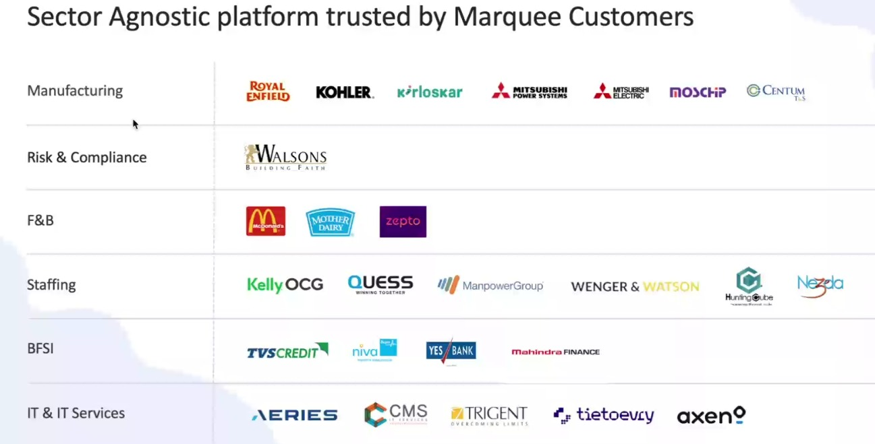
Our Clients

Slide 5
Working domain or the technology
Artificial Intelligence (AI) for intelligent recruitment automation
Machine Learning (ML) for resume screening and candidate ranking
Natural Language Processing (NLP) for chatbot and candidate interaction
Applicant Tracking System (ATS) architecture
SaaS (Software as a Service) cloud-based platform model
Database Management Systems for candidate and job data storage
REST APIs for integration with job portals and communication tools
Chatbot Technology (ERIKA – Robotic Recruiter)
Recruitment Analytics and Reporting Dashboards
Workflow Automation Systems

Slide 6
About your team and reporting Manager
Team Structure, Project, Reporting & Technology Understanding
Our team consists of 9 members, guided by our Reporting Manager, Mr. Ashish Meridatta.
Currently, we are in the training phase on the company’s ATS (Applicant Tracking System) product.
We are learning how each technology supports the recruitment process:
Technology Understanding:
AI & ML: Helps in resume screening and candidate ranking.
NLP: Enables chatbot communication and candidate interaction.
ATS Workflow: Helps track candidates across hiring stages.
Databases: Store and manage candidate and job data.
APIs: Integrate job portals and communication tools.
Dashboards & Analytics: Provide recruitment performance insights.
This training helps us understand how technology solves real recruitment challenges.
After training, we will be assigned to live projects for practical client exposure.

Slide 7
Challenges Faced in Internship
I was selected through my college campus placement process. Clearing the interview with the company’s CCO was a major challenge, as it involved in-depth technical questions, role-based scenarios, and problem-solving assessments. This experience tested my analytical thinking, technical knowledge, and ability to perform under pressure, helping me gain confidence and clarity about industry expectations.

Slide 8
Objectives of the work
To understand ATS system architecture and recruitment workflows.
To support AI-based resume parsing and candidate shortlisting processes.
To assist in database validation and candidate data management.
To ensure accurate workflow automation across hiring stages.
To support API-based integrations with job portals and communication tools.
To analyze recruitment dashboards and system reports.
To help in identifying and resolving basic system-level issues.
To improve overall system efficiency and data consistency.

Slide 9
Proposed System/Work
AI-Powered Applicant Tracking System
Automated resume screening and candidate ranking
Chatbot-based candidate engagement (ERIKA)
Centralized recruitment workflow management
Tailored Analytics and insights customize to specific clients and strategic plans
Power BI and Tableau integrations as per business plans

Slide 10
Problem Statement
The existing recruitment analytics process within the Talent Recruit (TR) system lacked an integrated Business Intelligence layer, resulting in heavy dependence on Excel-based data storage and external analysis. Recruitment data was maintained across multiple Excel files, leading to challenges in data consistency, version control, and manual effort in data preparation and reporting. Since analytics were performed outside the TR system, there was no centralized view of key recruitment metrics such as hiring trends, offer acceptance rates, and recruiter performance, limiting real-time visibility and delaying decision-making. Additionally, the absence of seamless integration between the data source and reporting layer created inefficiencies in generating insights, restricted scalability, and reduced the overall effectiveness of data-driven recruitment strategies. This highlighted the need for a unified, automated, and scalable analytics solution embedded directly within the TR system.

Slide 11
System Requirements
Web-based ATS platform
Cloud infrastructure
Database for candidate and job data
API integrations with job portals and communication tools
Power BI and Tableau API connectivity
Support for Advanced Analytics via REST APIs enabling real time data synchronization

Slide 12
System Requirements Cont…
Security aspects:
Role based data Access (RBAC)
Securing data Sharing across different clients.

Slide 13
Advantages of proposed System/Work
Reduces manual effort in recruitment
Improves hiring accuracy and speed
Enhances candidate experience
Supports data-driven hiring decisions
Data Driven Decision Making
Actionable Insights
Predictive Modeling

Slide 14
Advantages of proposed System/Work cont…
Improved Client and Stakeholder Satisfaction
High Fidelity Visuals.
Bespoke Client Reporting

Slide 15
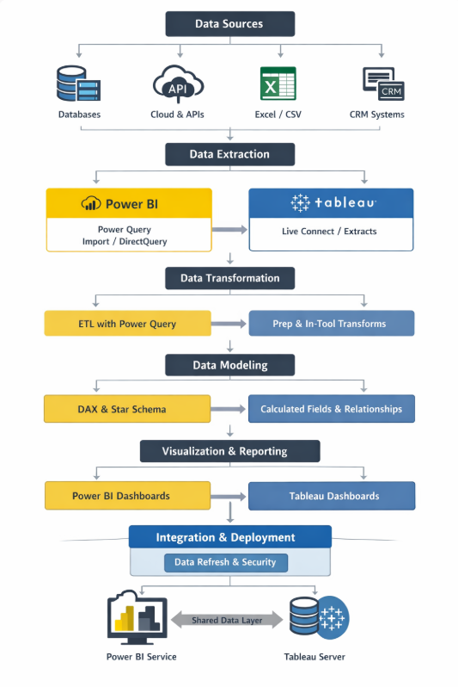
Working Process

Slide 16
Dashboard ready in Power BI
Built recruitment dashboards in Power BI Desktop
Connected Excel dataset extracted from TR system
Performed data cleaning and modeling
Created KPIs and visualizations
Published report to Power BI Service
👉 At this stage, dashboard exists but is not inside TR yet

Slide 17
Setting Up in Microsoft Azure.
Setting Up in Microsoft Azure
Logged into Microsoft Azure Portal
Registered a new application for TR system
Generated:
Client ID
Client Secret
Tenant ID
Configured API permissions for Power BI access
👉 This step gives identity to TR system

Slide 18
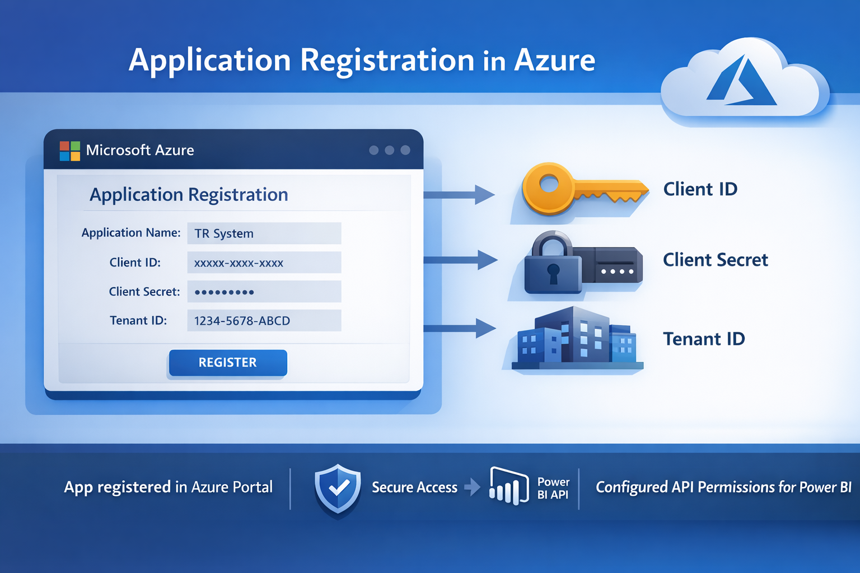
Backend Authentication Setup
Backend configured to connect with Azure AD
Used Client ID and Secret to request authentication
Implemented OAuth 2.0 flow
Azure validates and returns Access Token (JWT)
👉 Now backend is authorized to talk to Power BI

Slide 19
Connecting Backend to Power BI
Backend used Access Token to call Power BI APIs
Fetched report details (Report ID, Dataset info)
Called API to generate Embed Token
Embed Token created for secure dashboard access
👉 This step prepares dashboard for embedding

Slide 20
Parsing Data to Talent Recruit System
Backend sent:
Embed URL
Embed Token
Report ID
Integrated this into TR frontend logic
Ensured secure communication between layers
👉 Frontend now has everything needed to display dashboard

Slide 21
Embedding Dashboard in Talent Recruit System
Frontend used Power BI JavaScript SDK
Loaded dashboard using embed configuration
Dashboard rendered inside TR UI
Users can interact with reports (filters, slicers, etc.)
👉 Final outcome: Analytics available inside TR system

Slide 22
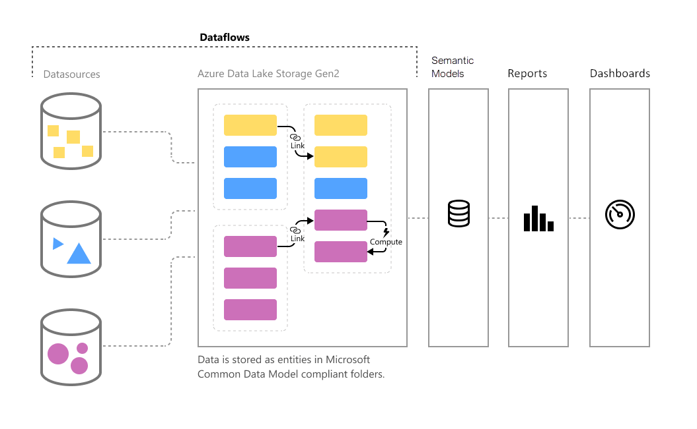
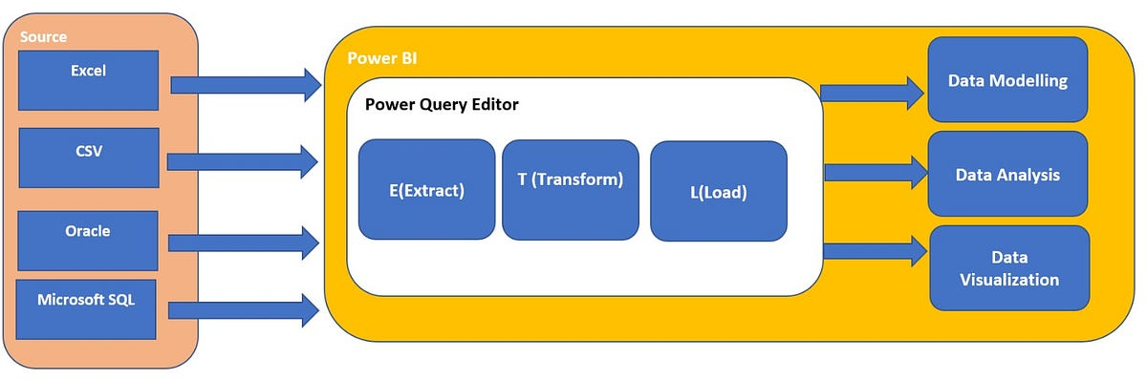
Architecture

Slide 23
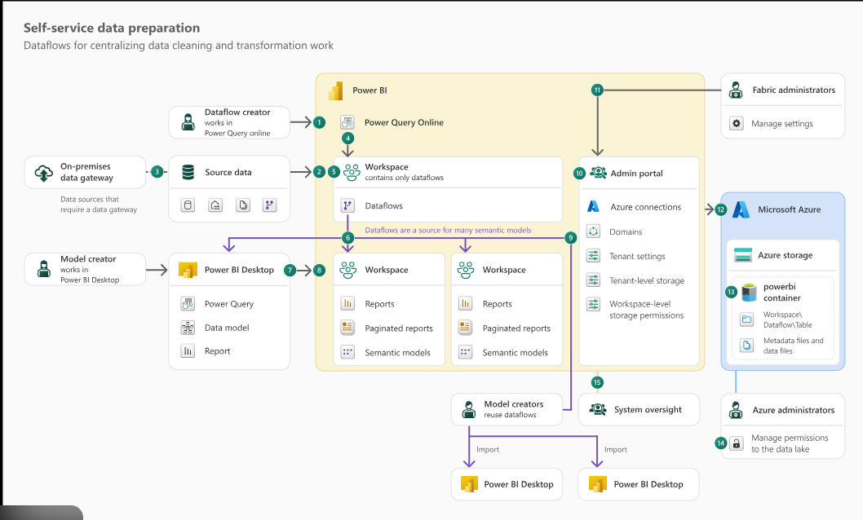

Slide 24
Outcome and Input
Centralized analytics within TR system
Enabled real-time insights for stakeholders
Reduced manual reporting effort significantly
Improved decision-making speed and accuracy
Created scalable and reusable analytics solution

Slide 25
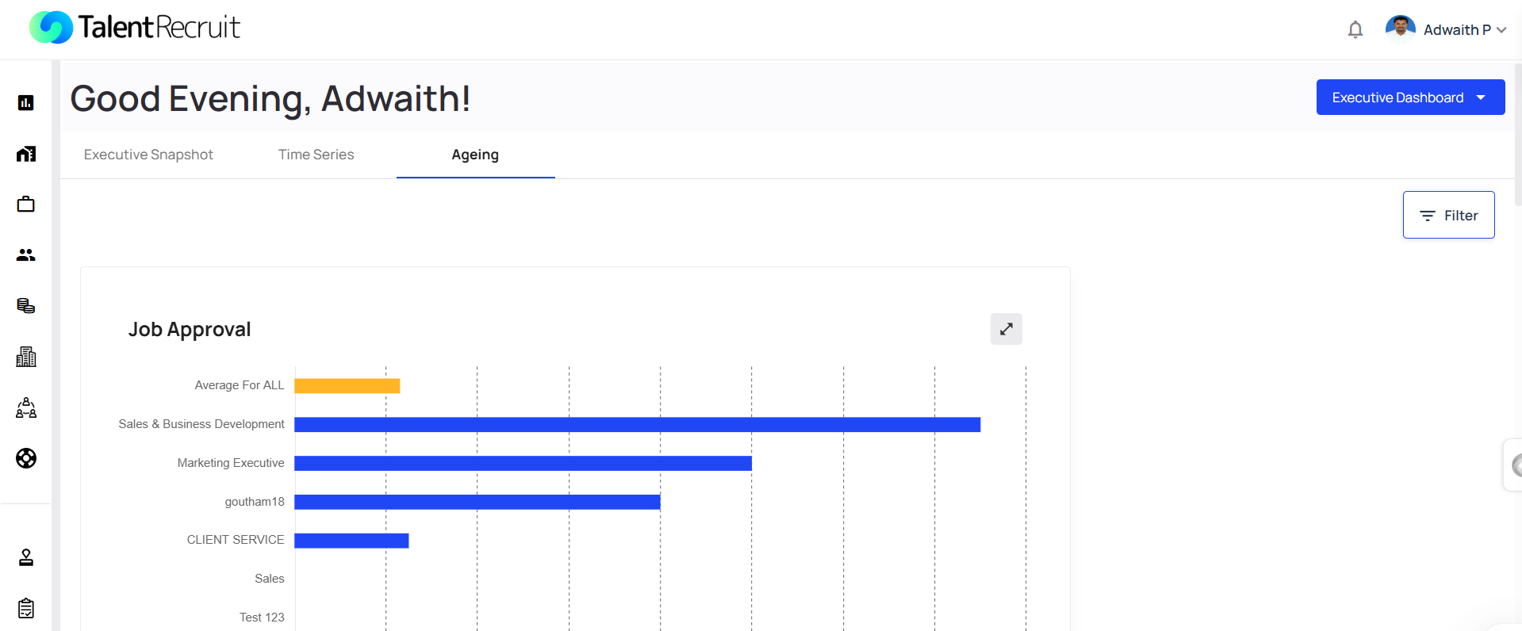
Advanced Analytics

Slide 26
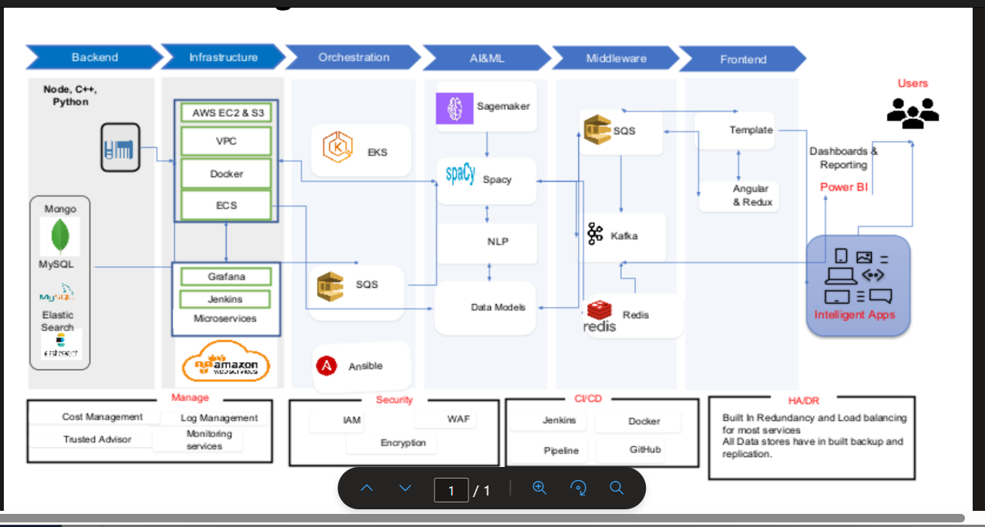
System Design

Slide 27
System Implementation
Architecture Model App-Owns-Data embedding approach Backend manages authentication and token generation
Authentication & Authorization Azure Active Directory (AAD) used for secure authentication Service Principal / App Registration configured OAuth 2.0 flow to generate Access Token (JWT)
Power BI REST API Integration Backend interacts with Power BI Service via REST APIs APIs used:
Get Reports API
Generate Embed Token API
Token Generation Flow Access Token → used to call Power BI APIs Embed Token → generated for secure report access Embed token is short-lived and scoped
Backend Responsibilities Handle secure API communication Generate and manage tokens Send Embed URL + Embed Token to frontend

Slide 28
System Implementation
Frontend Integration (TR System UI) Web-based TR SaaS application acts as presentation layer Receives Embed URL + Embed Token from backend
Power BI JavaScript SDK Used to render reports inside TR UI Supports interactive visuals, filters, and slicers
Embedding Mechanism Dynamic embedding using embed configuration Secure rendering using Embed Token Alternative: iFrame-based embedding (basic approach)
End-to-End Data Flow Excel Data → Power Query (ETL) → Data Model → Power BI Service → Backend (API + Token) → Frontend (JS SDK) → Embedded Dashboard
Security & Performance Role-Level Security (RLS) supported Controlled access via token-based authentication Optimized for low latency and scalable usage

Slide 29
Internship Road Map
Note: Write in the below table what u will be achieving in each review
Review 1
Product training and understanding the mechanisms
Review 2
Integrating all Advanced Analytics tools to the environments.
Review 3
Review 4
Final Review
Involved data modeling, DAX KPI creation, interactive dashboard development, slicers, drill-through analysis, and recruitment performance insights generation
ffff
We have integrated Power BI with our system for better analysis

Slide 30
Github Link
https://github.com/Jann-2004/Internship-Work-Adwaith_20221CBC0017

Slide 31
Q&A

Slide 32
Thank you !!

